Slide 1
What can I do with Google Earth Engine?
Matthew Bayly
Vancouver GIS User Group
February 12, 2020

Slide 2















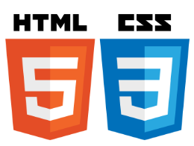


My spatial software ecosystem
Notes:
I’m always trying to figure out if i’ve got an ok setup

Slide 3
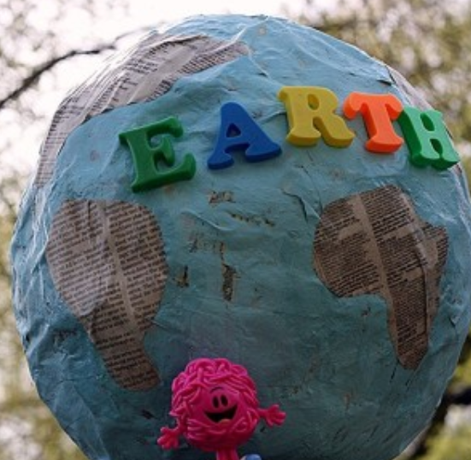
What is GEE?
A massive & ever growing collection of publically available remote sensing imagery backed by Google’s computing infrastructure.
This cloud-based application allows users to process massive amounts of Landsat, MODIS, Sentinel and other remote sensing imagery sources in seconds rather than hours, days or weeks.

Slide 4
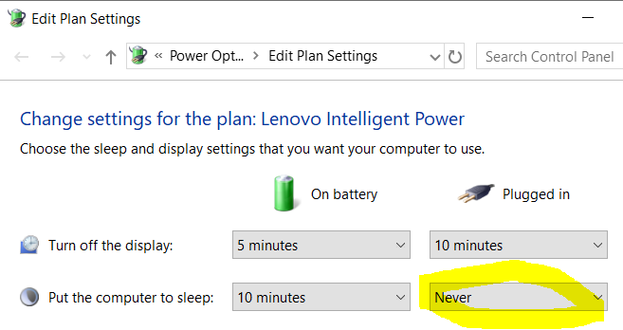
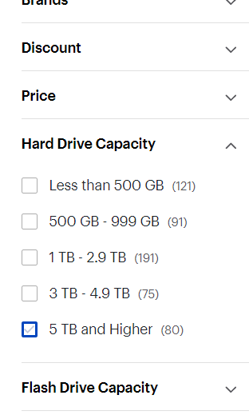
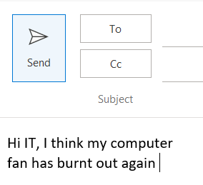
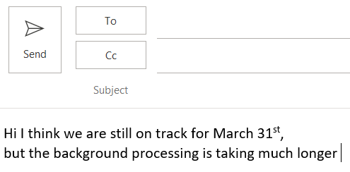
What does it do?
It eliminates a lot of the pre-processing and overhead work that deters most people from routinely working with big remotely sensed imagery.
Notes:
Divides data into independant grids

Slide 5
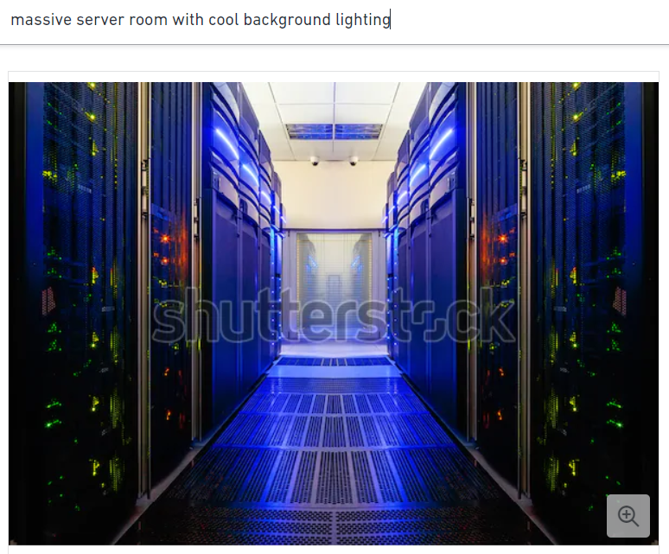
How does it work?
‘... borrows spare cycles from its network of supercomputers that normally run Google services such as Youtube and Gmail and serves the results of your analysis to you in tiled fashion like Google Maps does’

Slide 6
Ok. Now show me some cool end-product examples!

Slide 7
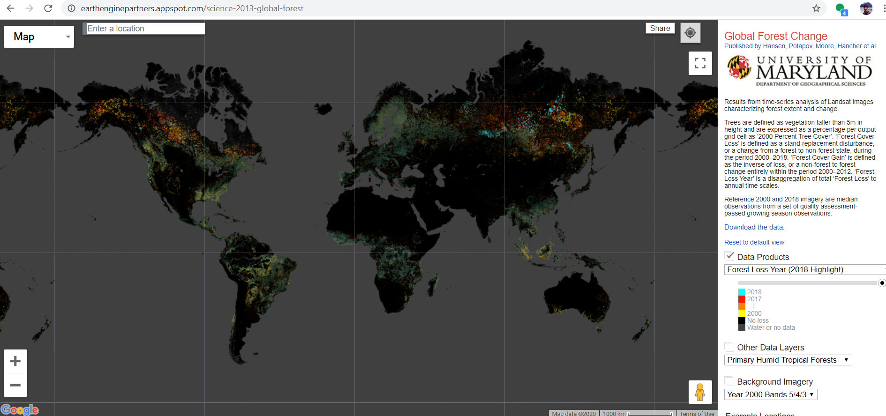
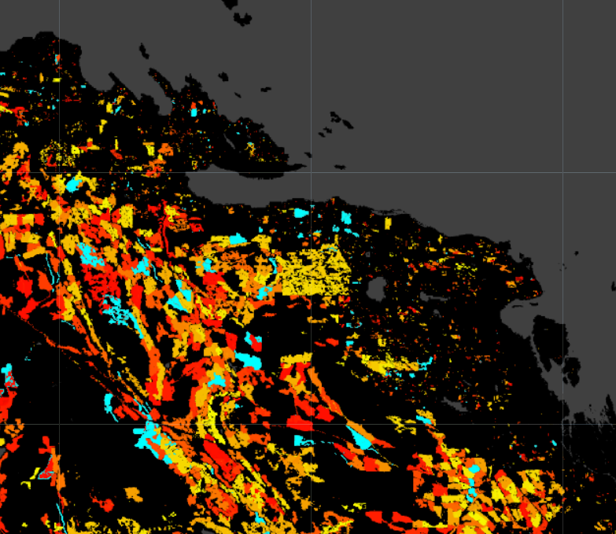
Quality is equivalent to the provincial VRI dataset in some locations!
https://earthenginepartners.appspot.com/science-2013-global-forest

Slide 8
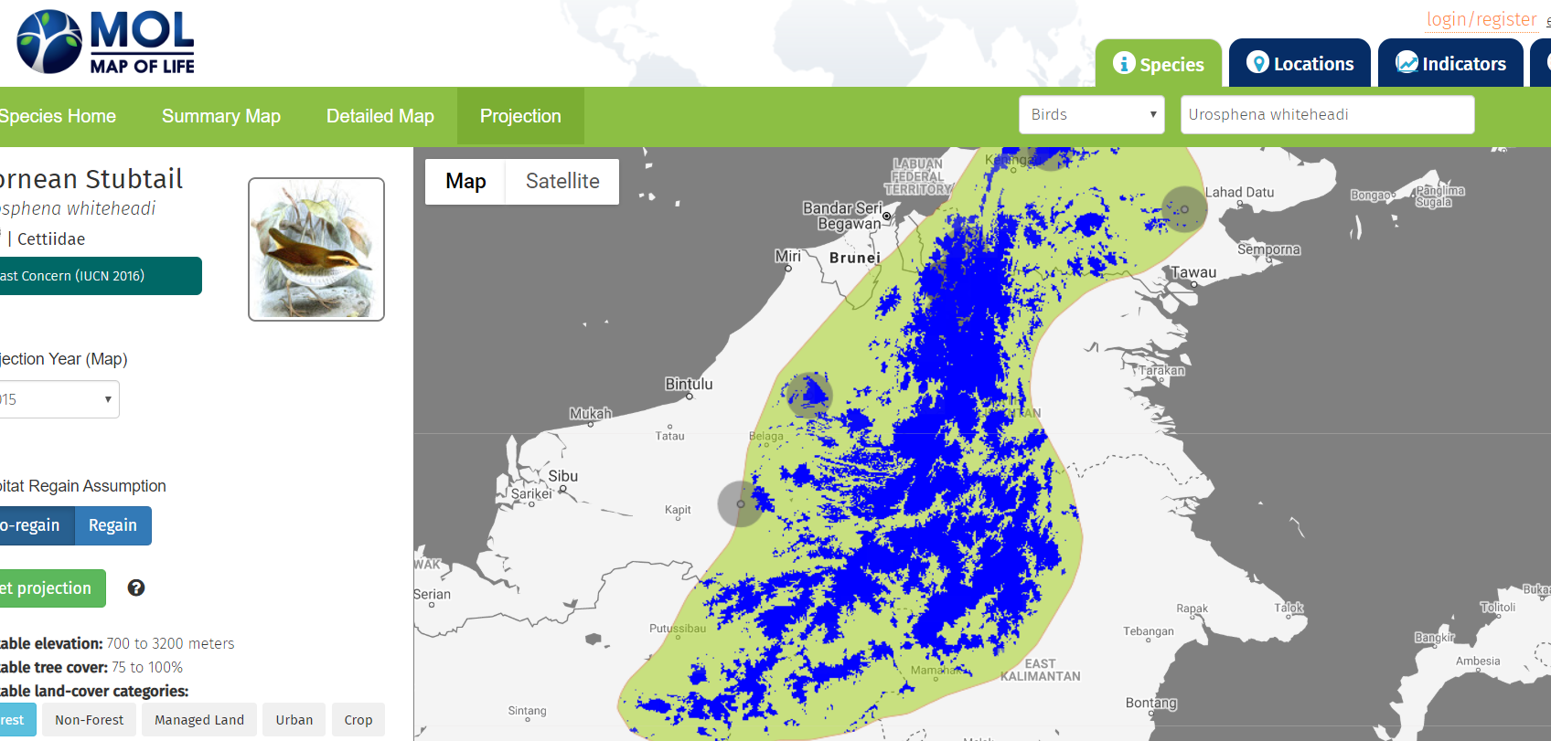
Map of life. Uses GEE API https://mol.org/species/projection/landuse/Urosphena_whiteheadi

Slide 9
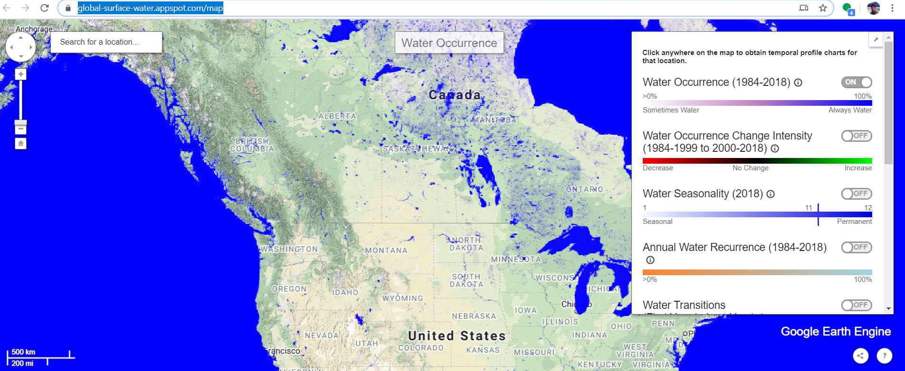
Global Water Surface Change Viewer https://global-surface-water.appspot.com/map

Slide 10
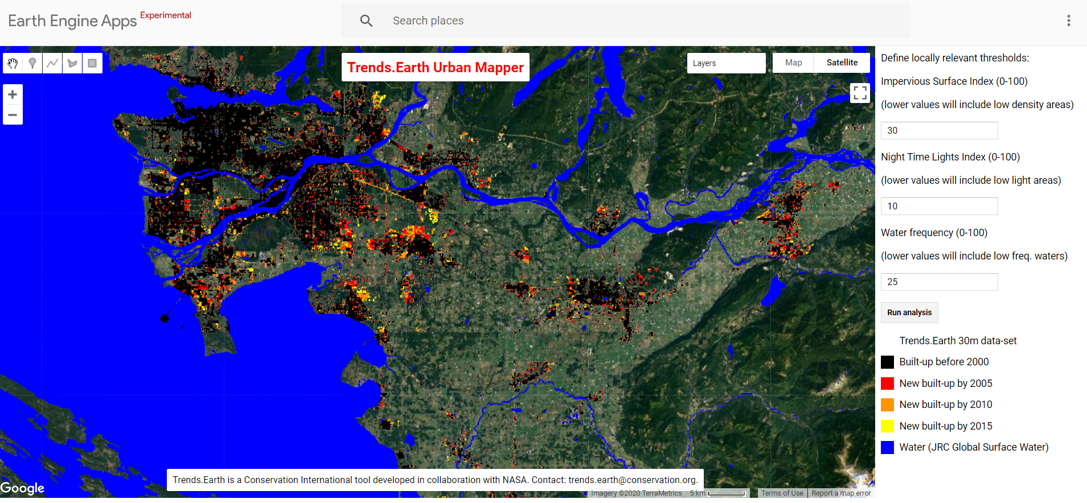
GEE Urban Mapper https://geflanddegradation.users.earthengine.app/view/trendsearth-urban-mapper

Slide 11
Will I be able to make the next revolutionary GEE App tomorrow?

Slide 12
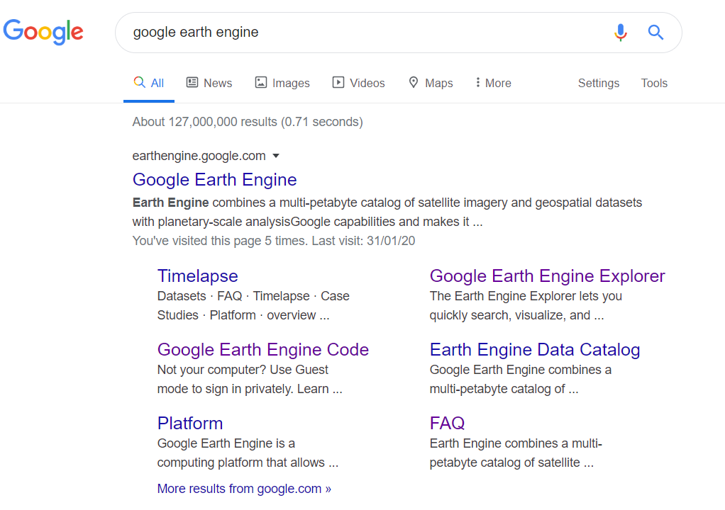
How can I use GEE?

Slide 13
How can I use GEE?
GEE Explorer: A GUI for viewing data. There is no coding here, but you can add multiple layers, filter dates and apply custom styles.
GEE Code Editor (a web-based IDE): Where most of the magic happens. Users can write unique functions, loops and create unique outputs for change detection and other applications

Slide 14
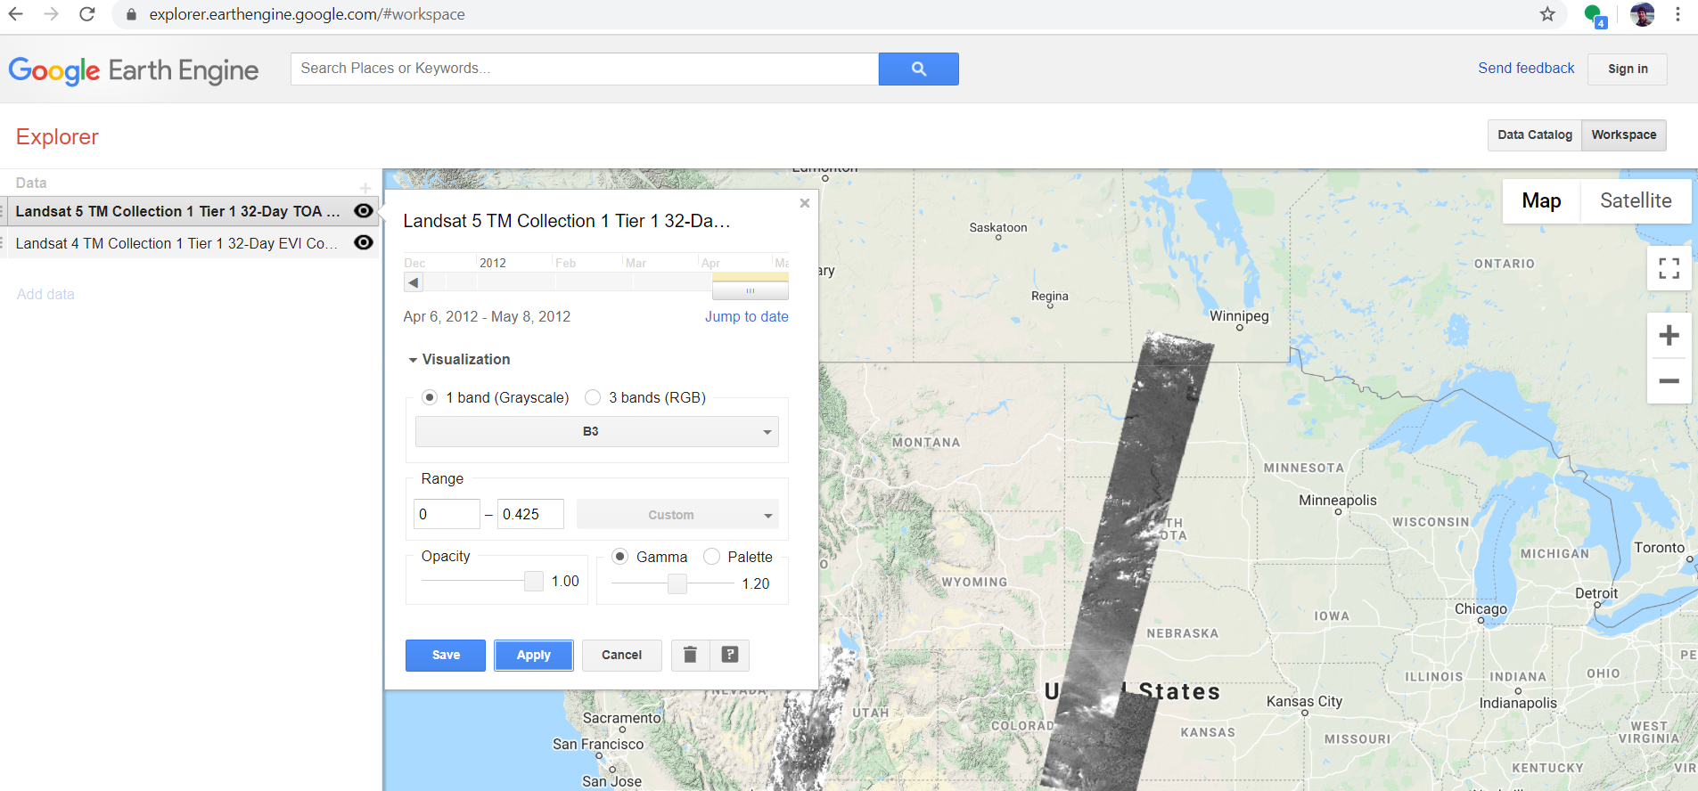
GEE Explorer - No code. For viewing only

Slide 15
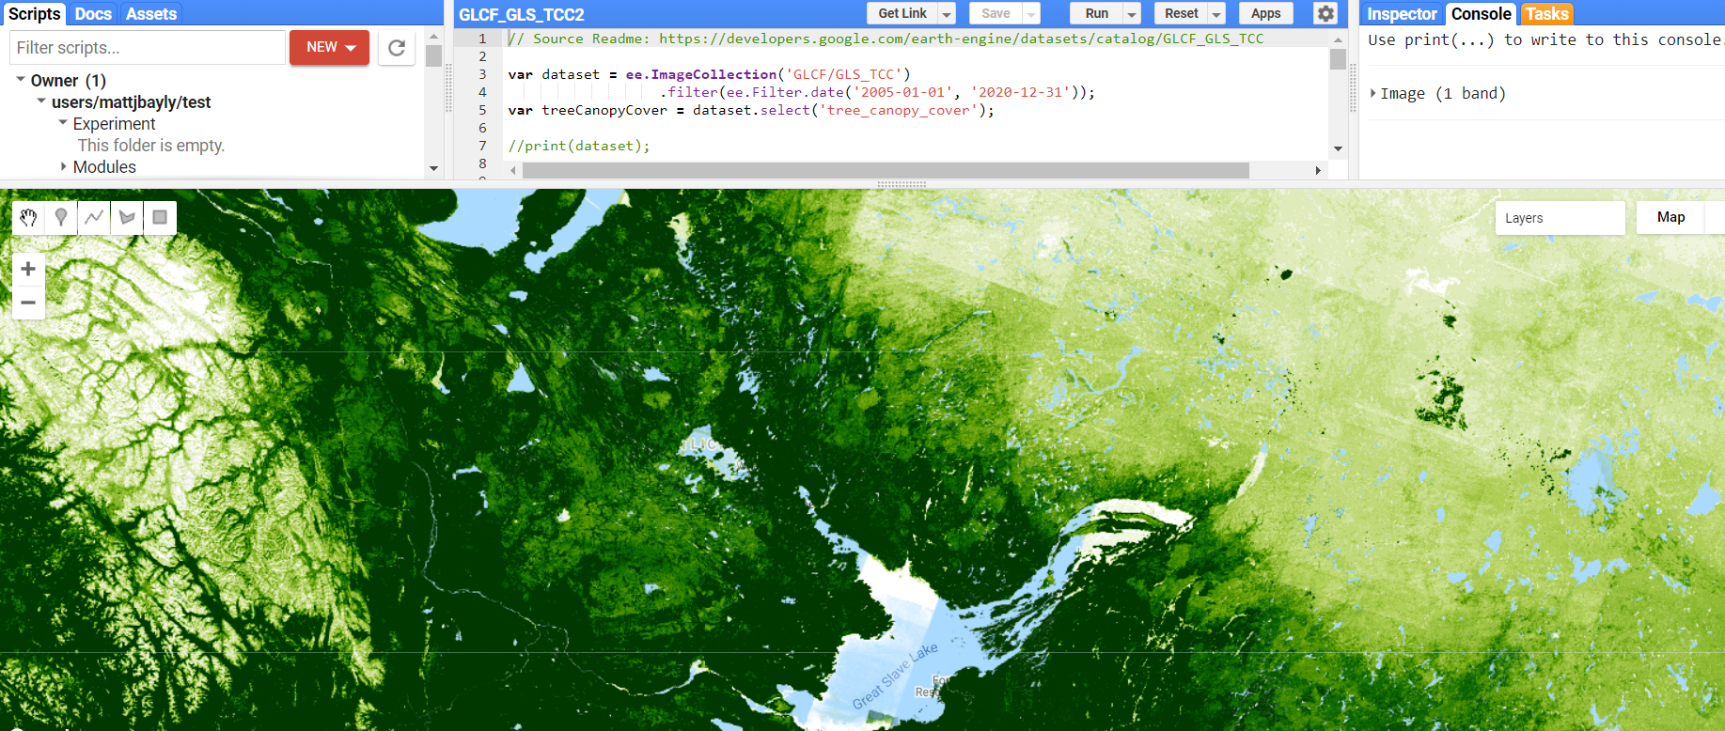
GEE Code Editor IDE - For viewing and coding

Slide 16
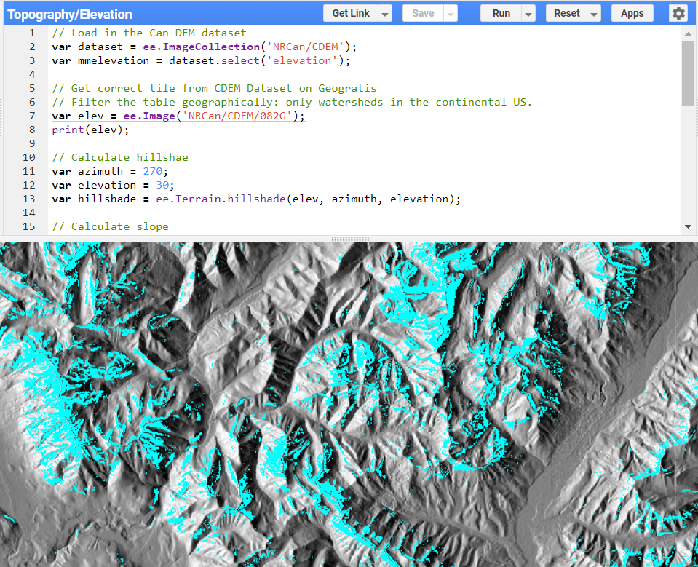
Elevation Hillshade and Slope

Slide 17
Pros of GEE?
Pros:
Good for big geographic-scale projects.
Great for rapid review of landsat/sentinel imagery for location X,Y and time Z.
Big list of mixed datasets: raw images, analysis ready, processed and end- products.
Advanced suite of functions and graphic/plot/summary options.
Big user group and lots of support on StackExchange etc.
Great tool for teaching fundamentals of remote sensing.

Slide 18
Cons of GEE?
Cons:
Users should have some really basic familiarity with JS or Python
Not well suited for big downloads and awkward to upload your own files - especially big geometry.
Analyses seem to be largely limited to pixel-based processing vs image segmentation and vector analysis.
Intent is for research & academic use - contact their commercial dept. for sustained commercial uses.
Mega projects like ‘Global Forest Change’ still require special support from Google.
Signup/application approval period can take up to several days for new users.

Slide 19
Why is Google working on this?
Google’s big data concept: To organize the world’s information that is too big for single server and make it universally accessible and usable.
Started as a side project from Google Maps in 2009 shortly after Landsat archive started to become public.

Slide 20
Demo:
Download a copy here for personal use

